Slide 1
Problematic

Slide 2
Work Force Aligment
Gather citizen informations
Analyse the colony’s profil
Administrator take decision according to analyses
Recommandation are given
User’s receive propositions

Slide 3
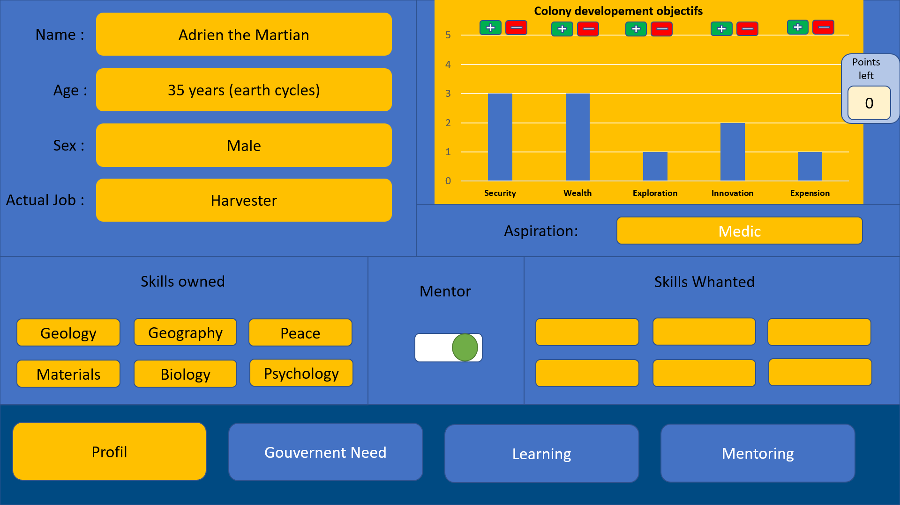
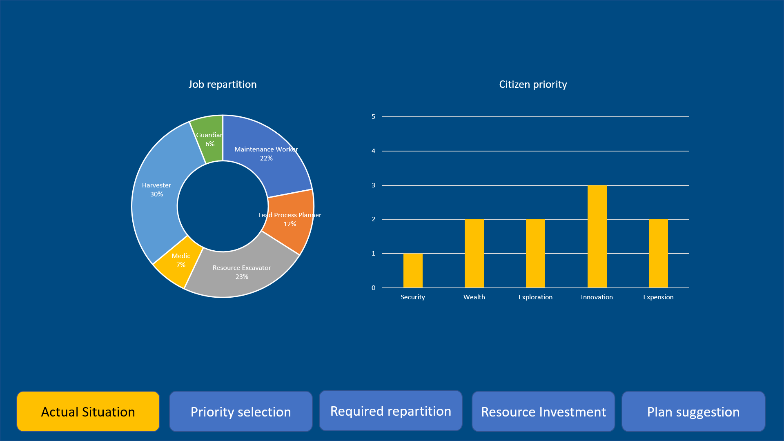
Two differents interfaces
Citizen
Administrator

Slide 4
Name :
Nom
Points left
Age :
Age
5
Sex :
Sex
Actual Job :
Job
Aspiration:
Choose one
Skills owned
Mentor
Skills Wanted
Profil
Gouvernent Need
Learning
Mentoring

Slide 5
Name :
Adrien the Martian
Points left
Age :
35 years (earth cycles)
5
Sex :
Male
Actual Job :
Harvester
Aspiration:
Choose one
Skills owned
Mentor
Skills Wanted
Profil
Gouvernent Need
Learning
Mentoring

Slide 6
Name :
Adrien the Martian
Points left
Age :
35 years (earth cycles)
0
Sex :
Male
Actual Job :
Harvester
Aspiration:
Medic
Choose one
Skills owned
Mentor
Skills Wanted
Profil
Gouvernent Need
Learning
Mentoring

Slide 7
Name :
Adrien the Martian
Points left
Age :
35 years (earth cycles)
Skills owned
0
Sex :
Realy Big
Structure
Electricity
Machine
Problem Solving
Programming
Actual Job :
Job
Planning
Peace Keeping
Battle
Geography
Project Management
Aspiration:
Medic
Geology
Materials
Research
Biology
Manual Labor
Skills owned
Mentor
Skills Whanted
Health
Cleaning
Pharmacy
Nutrition
Psychology
Profil
Gouvernent Need
Learning
Mentoring

Slide 8
Name :
Adrien the Martian
Points left
Age :
35 years (earth cycles)
Skills owned
0
Sex :
Realy Big
Structure
Electricity
Machine
Problem Solving
Programming
Actual Job :
Job
Planning
Peace Keeping
Battle
Geography
Project Management
Aspiration:
Medic
Geology
Materials
Research
Biology
Manual Labor
Skills owned
Mentor
Skills Whanted
Health
Cleaning
Pharmacy
Nutrition
Psychology
Profil
Gouvernent Need
Learning
Mentoring

Slide 9
Name :
Adrien the Martian
Points left
Age :
35 years (earth cycles)
0
Sex :
Male
Actual Job :
Harvester
Aspiration:
Medic
Choose one
Skills owned
Mentor
Skills Wanted
Geology
Geography
Peace
Materials
Biology
Psychology
Profil
Gouvernent Need
Learning
Mentoring

Slide 10
Name :
Adrien the Martian
Points left
Age :
35 years (earth cycles)
0
Sex :
Male
Actual Job :
Harvester
Aspiration:
Choose one
Medic
Medic
Choose one
Skills owned
Mentor
Skills Wanted
Profil
Gouvernent Need
Learning
Mentoring

Slide 11
Name :
Adrien the Martian
Points left
Age :
35 years (earth cycles)
Skills wanted
0
Sex :
Realy Big
Structure
Electricity
Machine
Problem Solving
Programming
Actual Job :
Job
Planning
Peace Keeping
Battle
Geography
Project Management
Aspiration:
Medic
Geology
Materials
Research
Biology
Manual Labor
Skills owned
Mentor
Skills Whanted
Health
Cleaning
Pharmacy
Nutrition
Psychology
Profil
Gouvernent Need
Learning
Mentoring

Slide 12
Name :
Adrien the Martian
Points left
Age :
35 years (earth cycles)
Skills wanted
0
Sex :
Realy Big
Structure
Electricity
Machine
Problem Solving
Programming
Actual Job :
Job
Planning
Peace Keeping
Battle
Geography
Project Management
Aspiration:
Medic
Geology
Materials
Research
Biology
Manual Labor
Skills owned
Mentor
Skills Whanted
Health
Cleaning
Pharmacy
Nutrition
Psychology
Profil
Gouvernent Need
Learning
Mentoring

Slide 13
Name :
Adrien the Martian
Points left
Age :
35 years (earth cycles)
0
Sex :
Male
Actual Job :
Harvester
Aspiration:
Choose one
Medic
Skills owned
Skills Wanted
Skills owned
Mentor
Geology
Geography
Peace
Structure
Machine
Programming
Materials
Biology
Psychology
Pharmacy
Project M
Manual L
Profil
Gouvernent Need
Learning
Mentoring

Slide 14
Name :
Adrien the Martian
Points left
Age :
35 years (earth cycles)
0
Sex :
Male
Actual Job :
Harvester
Aspiration:
Maintenance Worker
Lead Process Planner
Resource Excavator
Medic
Harvester
Guardian
Skills owned
Skills owned
Mentor
Skills Whanted
Geology
Geography
Peace
Materials
Biology
Psychology
Profil
Gouvernent Need
Learning
Mentoring

Slide 15
Name :
Adrien the Martian
Points left
Age :
35 years (earth cycles)
0
Sex :
Male
Actual Job :
Harvester
Aspiration:
Medic
Skills owned
Skills owned
Mentor
Skills Whanted
Geology
Geography
Peace
Materials
Biology
Psychology
Profil
Gouvernent Need
Learning
Mentoring

Slide 16
The 80 000 citizen fill their profils

Slide 17
Admin interface

Slide 18
Actual Situation
Priority selection
Required repartition
Resource Investment
Plan suggestion

Slide 19
Points left
5
Actual Situation
Priority selection
Required repartition
Resource Investment
Plan suggestion

Slide 20
Points left
0
Actual Situation
Priority selection
Required repartition
Resource Investment
Plan suggestion

Slide 21
AI analyse

Slide 22
Actual Situation
Priority selection
Required repartition
Resource Investment
Plan suggestion

Slide 23
Job’s priority
Skills priority
Medic
Guardian
Lead Process Planner
Maintenace Worker
Resource Excavator
Harvester
Health
Biology
Planning
Psychology
Manual labor
Problem solving
Actual Situation
Priority selection
Required repartition
Resource Investment
Plan suggestion

Slide 24
Short term objectifs
Middle term objectifs
Long term objectifs
Actual Situation
Priority selection
Required repartition
Resource Investment
Plan suggestion

Slide 25
Short term objectifs
Short term objectifs
During the following 4 weeks you should give :
Biology – 12 formations
Psychology – 8 formations
Manual Labor – 6 formations
Middle term objectifs
Long term objectifs
Actual Situation
Priority selection
Required repartition
Resources investmen
Plan suggestion

Slide 26
Short term objectifs
Middle term objectifs
Long term objectifs
Actual Situation
Priority selection
Required repartition
Resourcs Investment
Plan suggestion

Slide 27
Short term objectifs
Middle term objectifs
Middle term objectifs
During the following 12 weeks you should give :
Biology – 26 formations
Psychology – 13 formations
Manual Labor – 9 formations
Long term objectifs
Actual Situation
Priority selection
Required repartition
Resource Investment
Plan suggestion

Slide 28
Citizen interface

Slide 29
Job’s priority
Skills priority
Medic
Guardian
Lead Process Planner
Maintenace Worker
Resource Excavator
Harvester
Health
Biology
Planning
Psychology
Manual labor
Problem solving
Profil
Gouvernent Need
Learning
Mentoring

Slide 30
According to your Skill whanted, we suggest that you should assist at the following formations:
Biology – 25 mars
Psychology – 26 mars
Manual Labor – 29 mars
Profil
Gouvernent Need
Learning
Mentoring

Slide 31
According to your Skill whanted, we suggest that you could reach these Mantor :
Igor Strovitch – Programmation
Susan Mcoye – Research
Pablo Tremblay -Geology
Profil
Gouvernent Need
Learning
Mentoring

